Slide 1
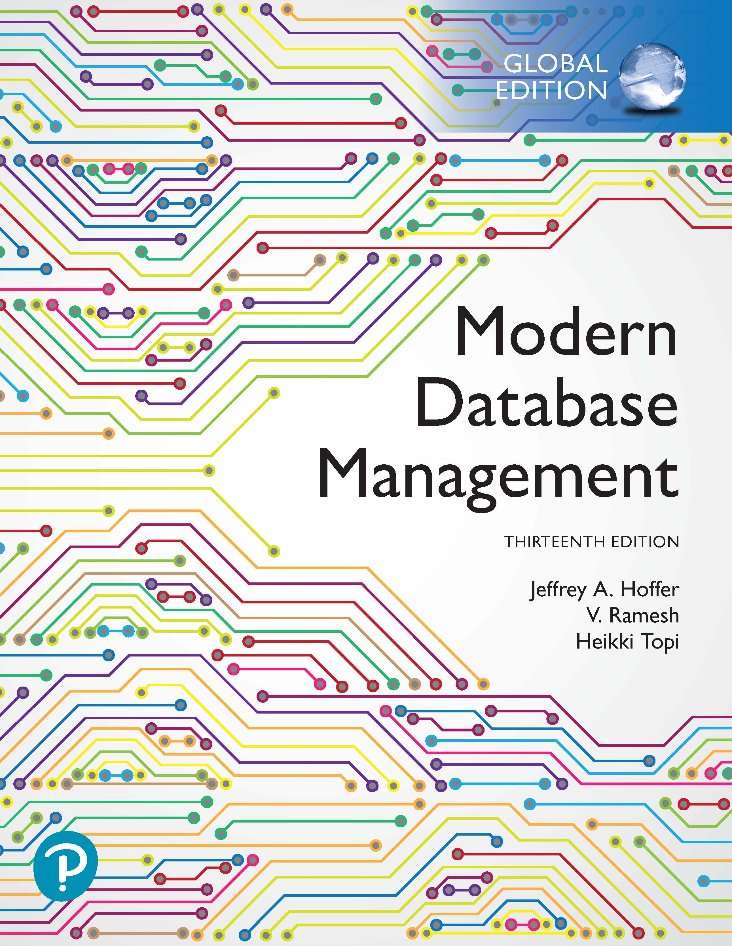
Modern Database Management
Thirteenth Edition, Global Edition
Chapter 6
Advanced S Q L
Copyright © 2020 Pearson Education Ltd. All Rights Reserved
Notes:
If this PowerPoint presentation contains mathematical equations, you may need to check that your computer has the following installed:
1) MathType Plugin
2) Math Player (free versions available)
3) NVDA Reader (free versions available)

Slide 2
Learning Objectives
6.1 Define terms
6.2 Write single- and multiple-table queries using S Q L commands
6.3 Define three types of join commands and use S Q L to write these commands
6.4 Write noncorrelated and correlated subqueries and know when to write each
6.5 Write queries to create dynamic and materialized views
6.6 Understand common uses of database triggers and stored procedures
6.7 Discuss the S Q L:2011 and S Q L:2016 standards and explain S Q L enhancements and extensions

Slide 3
Processing Multiple Tables (1 of 2)
Join
A relational operation that causes two or more tables with a common domain to be combined into a single table or view
Equi-join
A join in which the joining condition is based on equality between values in the common columns; common columns appear redundantly in the result table
Natural (inner) join
An equi-join in which one of the duplicate columns is eliminated in the result table
Notes:
Very often the data we want to see from a query needs to come from multiple tables. Most of the time these tables are linked in relationships via primary and foreign keys to implement 1:N relationships. The vast majority of joins involve matching primary and foreign keys, but there can also be other kinds of joins as well.

Slide 4
Processing Multiple Tables (2 of 2)
Outer join
A join in which rows that do not have matching values in common columns are nonetheless included in the result table (as opposed to inner join, in which rows must have matching values in order to appear in the result table)
Union join
Includes all data from each table that was joined
Notes:
Unions are not literally joins, and the syntax for expressing a union is not the same as the syntax for expressing a join. Nevertheless, unions also combine data from different tables.

Slide 5
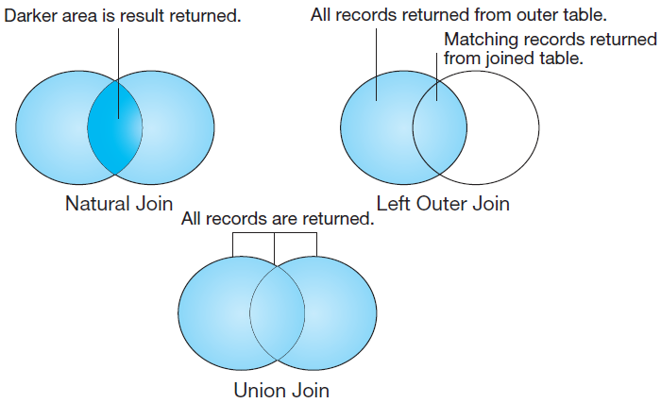
Figure 7-2 Visualization of Different Join Types with Results Returned in Shaded Area
Notes:
In this Venn diagram, the data from each table is represented as a circle. Natural joins will only return the records from each table that have a match in the join condition with the other table. This is also called an inner join. By contrast, with an outer join, the records from one table will be included even if there are no corresponding records from the other. With a union join, all records from both tables are returned. This can also be accomplished via a full outer join.

Slide 6
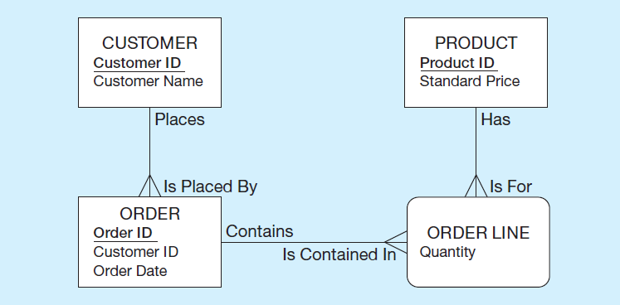
The Following Slides Create Tables for This Enterprise Data Model
(from Chapter 1, Figure 1-3)
Notes:
This is the E-R diagram from Chapter 1. Each of these entities, including the associative entity, is implemented as a table in the database.

Slide 7
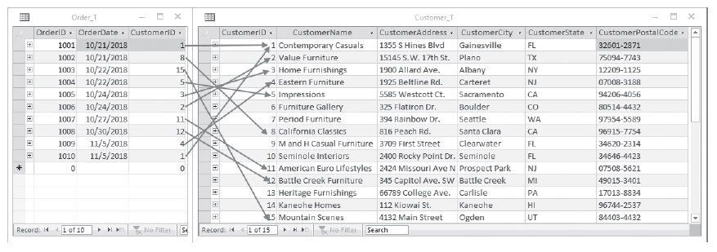
Figure 6-1 P V F Company Customer_T and Order_T Tables
With pointers from orders to the customers who placed them
Notes:
Customer_T and Order_T have a 1:N relationship, as you can see from the CustomerID foreign key in Order_T. These are two of the tables; the others are OrderLine_T and Product_T.
Order_T has a foreign key called CustomerID. This foreign key references the Customer_T table’s primary key, also called CustomerID.
These tables are used in the queries that follow.

Slide 8
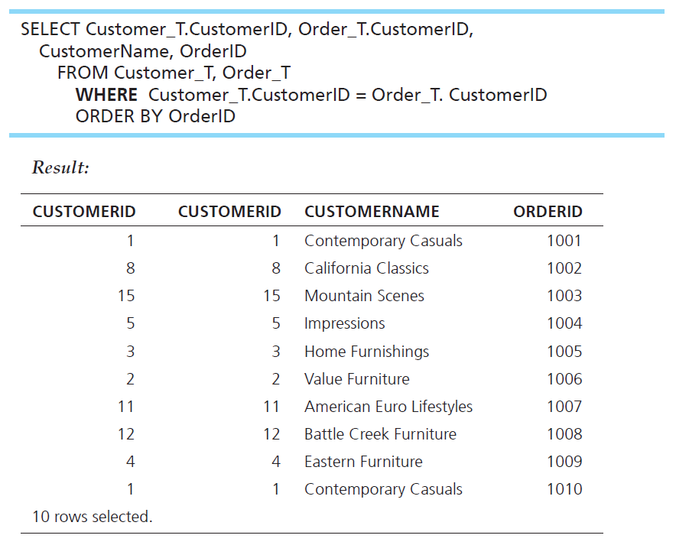
Equi-Join Example
What are the customer I Ds and names of all customers, along with the order I Ds for all the orders they have placed?
Notes:
This is an equi-join. Notice that the CustomerID is showing from both tables. It’s probably not necessary to see this, because they are always matched.
Notice also that 10 rows are returned in this query. There are 10 rows in the Order_T table, and only those rows from the Customer_T table with corresponding orders will be included. That’s because equi-joins are inner join by default.
The query:
SELECT Customer_T.CustomerID, Order_T.CustomerID, CustomerName, OrderID
FROM Customer_T, Order_T
WHERE Customer_T.CustomerID = Order_T. CustomerID
ORDER BY OrderID
The results:
CUSTOMERID CUSTOMERID CUSTOMERNAME ORDERID
1 1 Contemporary Casuals 1001
8 8 California Classics 1002
15 15 Mountain Scenes 1003
5 5 Impressions 1004
3 3 Home Furnishings 1005
2 2 Value Furniture 1006
11 11 American Euro Lifestyles 1007
12 12 Battle Creek Furniture 1008
4 4 Eastern Furniture 1009
1 1 Contemporary Casuals 1010
10 rows selected.

Slide 9
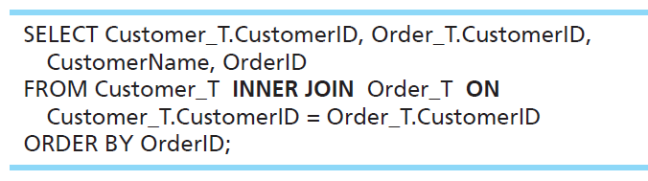
Equi-Join Example – Alternative Syntax An INNER Join
INNER JOIN clause is an alternative to WHERE clause, and is used to match primary and foreign keys.
An INNER join will only return rows from each table that have matching rows in the other.
This query produces the same results as the previous equi-join example.
Notes:
For join conditions, sometimes this syntax is used instead of the WHERE clause. This way you can distinguish between conditions that are used for matching records between tables vs. conditions used for selecting which rows to return (as we learned about in Chapter 5).
A join involves multiple tables in FROM clause. The ON clause performs the equality check for common columns of the two tables
Note: From Figure 6-1, you see that there are 15 customers, but only 10 of them have links with orders.
Therefore, only 10 rows will be returned from this INNER join.
SELECT Customer_T.CustomerID, Order_T.CustomerID, CustomerName, OrderID
FROM Customer_T INNER JOIN Order_T ON Customer_T.CustomerID = Order_T.CustomerID
ORDER BY OrderID;

Slide 10
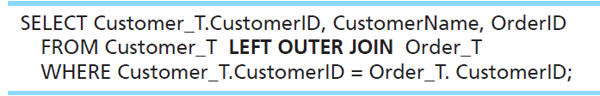
Outer-Join Example
List the customer name, I D number, and order number for all customers. Include customer information even for customers that do not have an order.
LEFT OUTER JOIN clause causes rows from the first mentioned table (customer) to appear even if there is no corresponding order data.
Unlike an INNER join, this will include customer rows with no matching order rows.
For the tables in figure 6.1, this will return 16 rows. That’s because there are 15 customers, and one of these customers has 2 orders.
Notes:
The query:
SELECT Customer_T.CustomerID, CustomerName, OrderID
FROM Customer_T LEFT OUTER JOIN Order_T
WHERE Customer_T.CustomerID = Order_T. CustomerID;

Slide 11
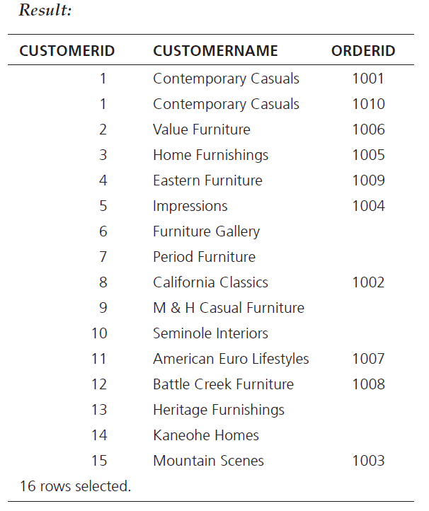
Result
Note two rows for customer #1 Contemporary Casuals.
Also note that several customers don’t have orders.
This is because of the left outer join.
Notes:
Result:
CUSTOMERID CUSTOMERNAME ORDERID
1 Contemporary Casuals 1001
1 Contemporary Casuals 1010
2 Value Furniture 1006
3 Home Furnishings 1005
4 Eastern Furniture 1009
5 Impressions 1004
6 Furniture Gallery
7 Period Furniture
8 California Classics 1002
9 M & H Casual Furniture
10 Seminole Interiors
11 American Euro Lifestyles 1007
12 Battle Creek Furniture 1008
13 Heritage Furnishings
14 Kaneohe Homes
15 Mountain Scenes 1003
16 rows selected.

Slide 12
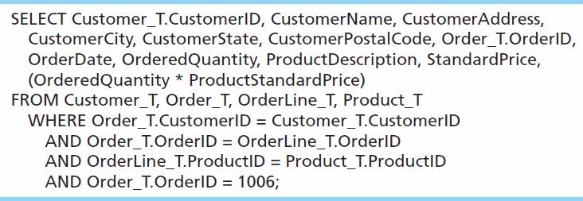
Multiple Table Join Example
Assemble all information necessary to create an invoice for order number 1006.
Each pair of tables requires an equality-check condition in the WHERE clause, matching primary keys against foreign keys.
Notes:
There are four tables involved in this join. Therefore there are three join conditions. In general, if there are n tables, there will be n-1 join conditions.
The final condition (OrderID = 1006) is not a join condition. This is a condition that restricts the number of rows returned, not one that connects tables.
This is why the join syntax (inner join, outer join, etc.) may be preferable. Using that syntax, join conditions are clearly distinguished from other conditions.

Slide 13
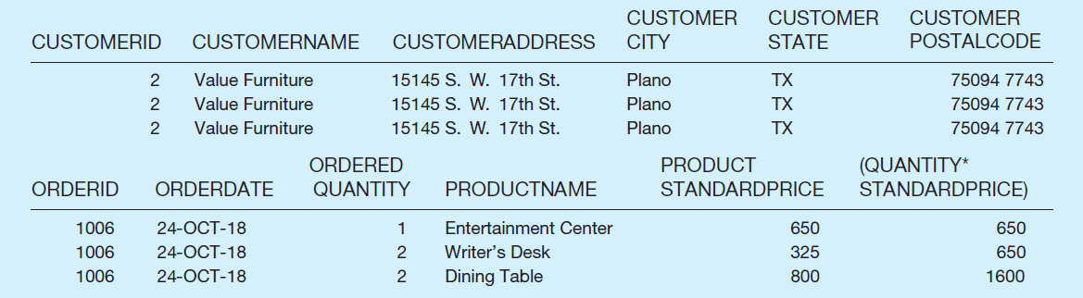
Figure 6-4 Results from a Four-Table Join (Edited for Readability)
All rows returned from this query will pertain to Order I D 1006.
Note that the full query results include columns from four different tables.
Notes:
CUSTOMERID
2
2
2
CUSTOMERNAME
Value Furniture
Value Furniture
Value Furniture
CUSTOMERADDRESS
15145 S. W. 17th St.
15145 S. W. 17th St.
15145 S. W. 17th St.
CUSTOMER
CITY
Plano
Plano
Plano
CUSTOMER
STATE
TX
TX
TX
CUSTOMER
POSTALCODE
75094 7743
75094 7743
75094 7743
ORDERID
1006
1006
1006
ORDERDATE
24-OCT-18
24-OCT-18
24-OCT-18
ORDERED
QUANTITY
1
2
2
PRODUCTNAME
Entertainment Center
Writer’s Desk
Dining Table
PRODUCT
STANDARDPRICE
650
325
800
(QUANTITY*
STANDARDPRICE)
650
650
1600

Slide 14
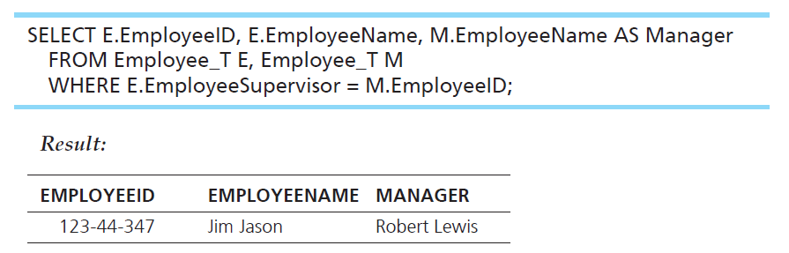
Self Join Example
What are the employee ID and name of each employee and the name of his or her supervisor (label the supervisor’s name Manager)?
The same table is used on both sides of the join; distinguished using table aliases. See the next slide for details.

Slide 15
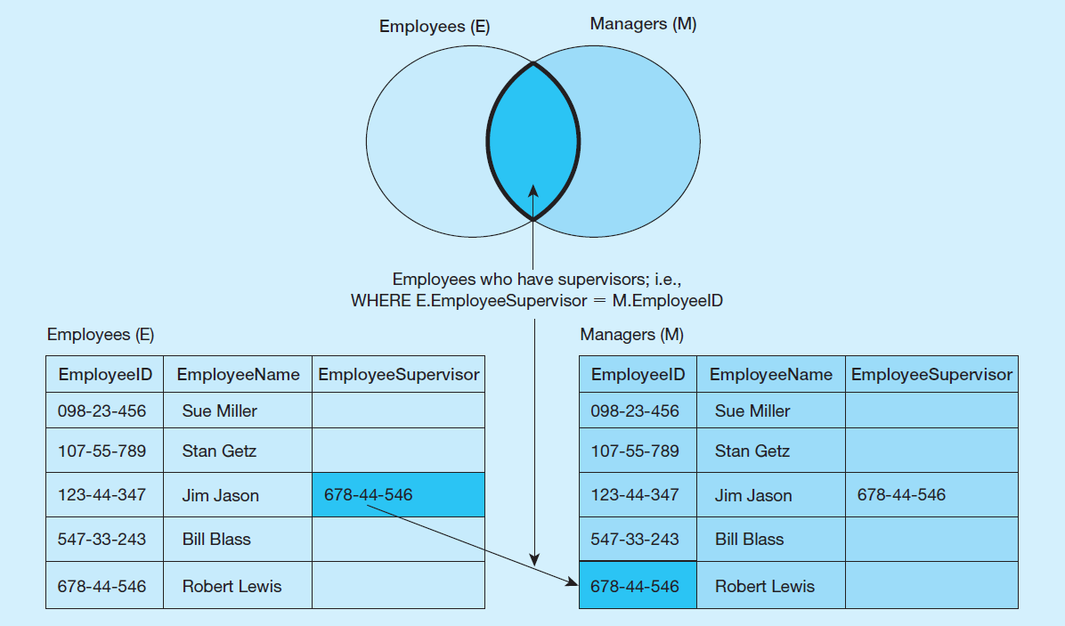
Figure 6-5 Example of a Self Join
Self join involve tables that implement 1-to-many unary relationships.
Notes:
Suppose you have a table of five employees as shown here. Only one of these employees has a supervisor. The EmployeeSupervisor column would be a foreign key in the Employees table which is associated with the primary key EmployeeID. We saw an E-R diagram showing the same sort of thing in Chapter 2. So, a self join is associated with a unary relationship.

Slide 16
Subqueries
Subquery – placing an inner query (SELECT statement) inside an outer query
Options:
In a condition of the WHERE clause
As a “table” of the FROM clause
Returning a field for the SELECT clause
Within the HAVING clause
Subqueries can be:
Noncorrelated – executed once for the entire outer query
Correlated – executed once for each row returned by the outer query
Notes:
Subqueries are usually placed in the WHERE or HAVING clause of the outer query. In this case, the subquery’s results are used to test a condition for the outer query’s WHERE or HAVING clause. If the condition is a test comparing the subquery result to another value, then the subquery should return a single value (one row consisting of one column). If it is used in an IN test or an ALL test of a WHERE clause, it can return a list of values (multiple rows, each with one column). If used in an EXISTS test, there is no limit to the rows and columns returned from the subquery.
It is also possible to put subqueries in the FROM clause of an outer query, instead of a table. In this case there is no restriction on how many rows or columns should be returned from the subquery, but the subquery’s columns must be consistent with the columns in the SELECT clause of the outer query.
If a subquery is used in the SELECT clause, the subquery’s result should be a single value, and this value becomes a column of the outer query.
When using multiple tables, sometimes you need a subquery, sometimes you need a join. Other times, the problem can be solved by either a subquery or a join. It is also possible to combine joins and subqueries together.

Slide 17
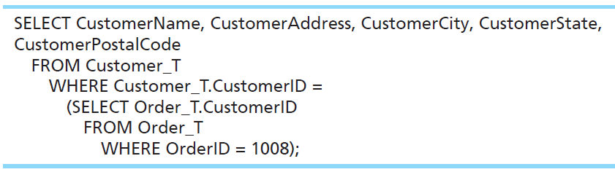
Subquery Example
What are the name and address of the customer who placed order number 1008?
Notes:
First, the subquery returns customer ID for the OrderID 1008. That value is then used in the WHERE condition of the outer query. Note: Since the WHERE clause is testing for equality, the subquery must return a single row with a single column.
Note that a subquery is embedded between parentheses.
The query:
SELECT CustomerName, CustomerAddress, CustomerCity, CustomerState,
CustomerPostalCode
FROM Customer_T
WHERE Customer_T.CustomerID =
(SELECT Order_T.CustomerID
FROM Order_T
WHERE OrderID = 1008);

Slide 18
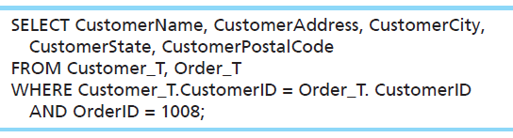
Alternative Approach, Using a Join
What are the name and address of the customer who placed order number 1008?
Notes:
Sometimes you can accomplish the same result in different ways. The previous subquery could have been done via this join.
The join query:
SELECT CustomerName, CustomerAddress, CustomerCity,
CustomerState, CustomerPostalCode
FROM Customer_T, Order_T
WHERE Customer_T.CustomerID = Order_T. CustomerID
AND OrderID = 1008;

Slide 19
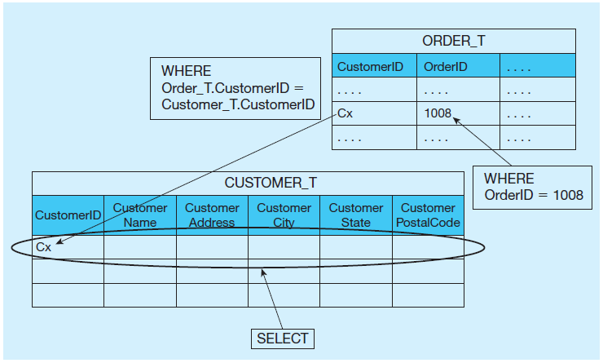
Figure 6-6 Graphical Depiction of Two Ways to Answer a Query with Different Types of Joins (1 of 2)
a) Join query approach
Notes:
The joining technique is useful when data from several relations are to be retrieved and displayed, and the relationships are not necessarily nested, whereas the subquery technique allows you to display data from only the tables mentioned in the outer query. For example with the join we could see the OrderID, but not with the subquery.
A join involves a cross product which combines all combinations of rows from each of the tables, followed by removing the rows that don’t match according to the conditions of the join.

Slide 20
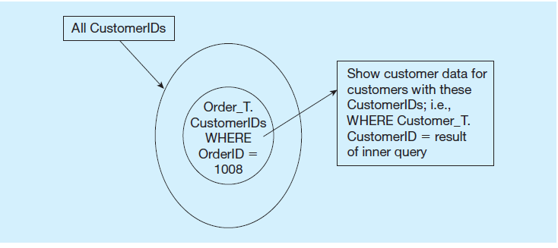
Figure 6-6 Graphical Depiction of Two Ways to Answer a Query with Different Types of Joins (2 of 2)
b) Subquery approach
Notes:
A subquery operates differently from a join. First, the subquery executes, which returns a result. Then that result is used in the outer query.
So, for these examples, although the results are the same, the execution that gave the results are quite different.

Slide 21
Correlated versus. Noncorrelated Subqueries
Noncorrelated subqueries:
Do not depend on data from the outer query
Execute once for the entire outer query
Correlated subqueries:
Make use of data from the outer query
Execute once for each row of the outer query
Can use the EXISTS and ALL operators
Notes:
Correlated subqueries use the result of the outer query to determine the processing of the inner query. That is, the inner query is somewhat different for each row referenced in the outer query. In this case, the inner query must be computed for each row processed in the outer query, whereas in the earlier examples, the inner query was computed only once for all rows processed in the outer query.

Slide 22
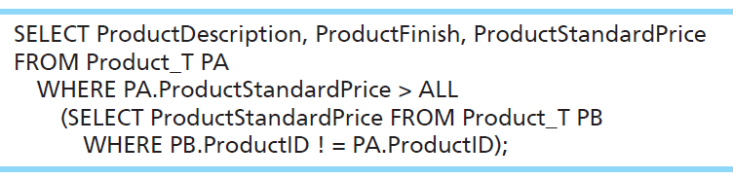
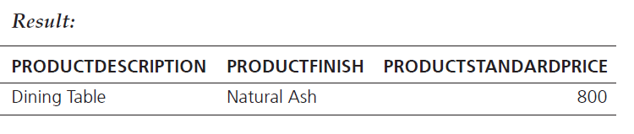
Example of a Correlated Subquery
List the details about the product with the highest standard price.
Notes:
Note that the outer query uses Product_T with a PA alias in its FROM clause. The subquery also uses Product_T in its FROM clause but with a PB alias.
The subquery also references the PA alias from the outer query, which makes the subquery correlated.
Query:
SELECT ProductDescription, ProductFinish, ProductStandardPrice
FROM Product_T PA
WHERE PA.ProductStandardPrice > ALL
(SELECT ProductStandardPrice FROM Product_T PB
WHERE PB.ProductID ! = PA.ProductID);
Result:
PRODUCTDESCRIPTION PRODUCTFINISH PRODUCTSTANDARDPRICE
Dining Table Natural Ash 800

Slide 23
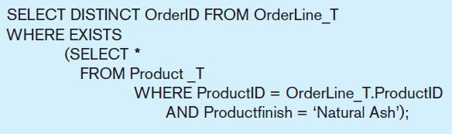
Another Correlated Subquery
What are the order I Ds for all orders that have included furniture finished in natural ash?
A correlated subquery always refers to an attribute from a table referenced in the outer query.
Notes:
The key feature that identifies a correlated subquery is the fact that the subquery makes reference to a column from the outer query. Note that OrderLine_T is a table used in the FROM clause of the outer query, but is not a table in the FROM clause of the inner query. Yet, the WHERE clause of the inner query does refer to a column from OrderLine_T, specifically the ProductID.
If your subquery has a reference to a table in the outer query, that makes it a correlated subquery. If it does not have such a reference, then it is a noncorrelated subquery. Here, the subquery is testing for a value that comes from rows processed in the outer query. Specifically, the OrderLine_T table, which is in the FROM clause of the outer query, but not the subquery.
The EXISTS operator will return a TRUE value if the subquery resulted in a non-empty set, otherwise it returns a FALSE.

Slide 24
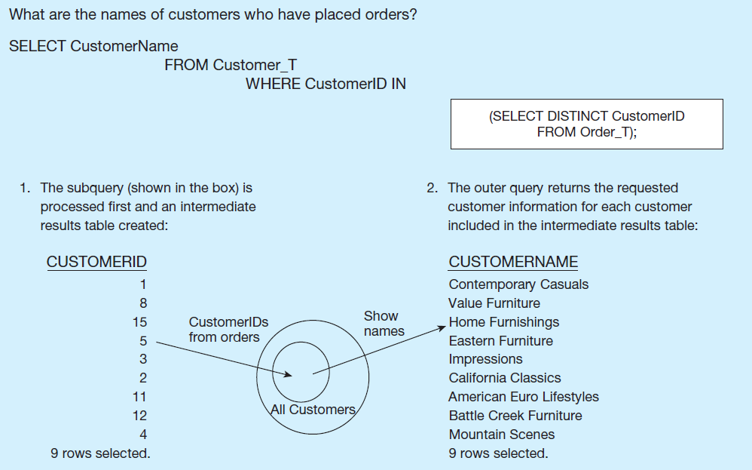
Figure 6-8 Subquery Processing (1 of 2)
a) Processing a noncorrelated subquery

Slide 25
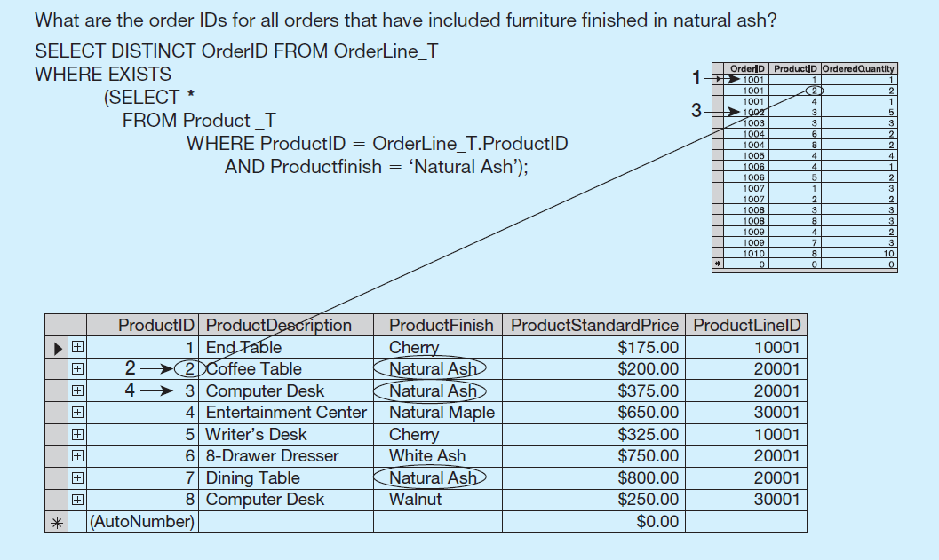
Figure 6-8 Subquery Processing (2 of 2)
b) Processing a correlated subquery
Notes:
In this case the subquery will execute once for each row of the outer query. In this example, the outer query goes through each row of the OrderLine_T table. Each time it gets to a row, that particular row’s product ID is used in the subquery to get the product of that particular order line. There are 17 order line records, so the subquery will execute 17 times, one for each order line record.
So, you can see the difference in behaviors of correlated vs. noncorrelated queries. With a non-correlated query, the inner query executes once, and then the outer query executes. For a correlated subquery, the outer query executes, and for each row of the outer query the inner query will execute once.
The first order ID is selected from OrderLine_T: OrderID 51001.
2. The subquery is evaluated to see if any product in that order has a natural ash finish. Product 2 does, and is part of the order. EXISTS is valued as true and the order ID is added to the result table.
3. The next order ID is selected from OrderLine_T: OrderID 51002.
4. The subquery is evaluated to see if the product ordered has a natural ash finish. It does. EXISTS is valued as true and the order ID is added to the result table.
5. Processing continues through each order ID. Orders 1004, 1005, and 1010 are not included in the result table because they do not include any furniture with a natural ash finish.

Slide 26
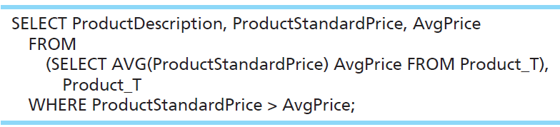
Derived Table (Subquery in the FROM Clause of the Outer Query)
What are the order I Ds for all orders that have included furniture finished in natural ash?
Here, the subquery forms the derived table used in the FROM clause of the outer query. The AvgPrice column from the subquery is used in the SELECT clause of the outer query.
Notes:
Here we have a case where the subquery is in the FROM clause of the outer query. This is often called a “derived table”, because normally you see tables in the FROM clause.
Because aggregate functions cannot be done in the WHERE clause, it is often useful to use subqueries when you want your conditions to include aggregate results.
For example, this query would not have worked:
SELECT ProductDescription, ProductStandardPrice FROM Product_T
WHERE ProductStandardPrice > AVG(ProductStandardPrice);
So instead we do what the slide is showing.
The query:
SELECT ProductDescription, ProductStandardPrice, AvgPrice
FROM
(SELECT AVG(ProductStandardPrice) AvgPrice FROM Product_T),
Product_T
WHERE ProductStandardPrice > AvgPrice;

Slide 27
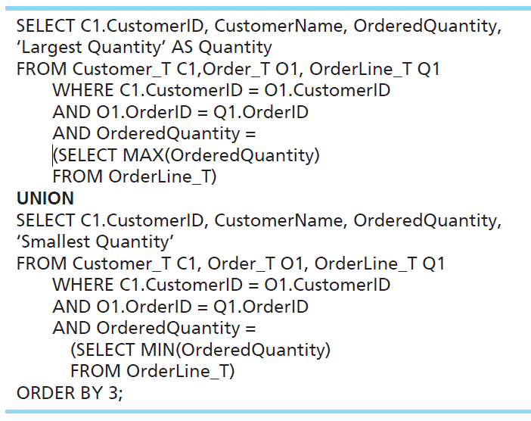
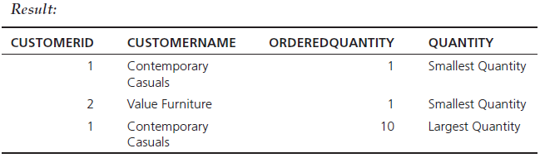
UNION — Combining Queries
Combine the output (union of multiple queries) together into a single result table
With UNION queries, the quantity and data types of the attributes in the SELECT clauses of both queries must be identical.
Notes:
This query determines the customer(s) who has in a given line item purchased the largest quantity of any Pine Valley product and the customer(s) who has in a given line item purchased the smallest quantity and returns the results in one table.
To use the UNION clause, each query involved must output the same number of columns, and they must be UNION compatible. This means that the output from each query for each column should be of compatible data types.
Note: Although these queries involve subqueries, this is not necessary for unions. It just so happens we’re doing it in this example.
In general a UNION is structured like this:
SELECT statement
UNION
SELECT statement
It is possible to use UNION with many different SELECT statements. Here we perform a single UNION operation combining just two of them.
Note another feature of this example. It is possible for the SELECT clause to include literal values in its returned column list. See the words ‘Smallest Quantity’ and ‘Largest Quantity’. These are not values in the tables, but can still be shown in the results.
The query:
SELECT C1.CustomerID, CustomerName, OrderedQuantity,
‘Largest Quantity’ AS Quantity
FROM Customer_T C1,Order_T O1, OrderLine_T Q1
WHERE C1.CustomerID = O1.CustomerID
AND O1.OrderID = Q1.OrderID
AND OrderedQuantity =
(SELECT MAX(OrderedQuantity)
FROM OrderLine_T)
UNION
SELECT C1.CustomerID, CustomerName, OrderedQuantity,
‘Smallest Quantity’
FROM Customer_T C1, Order_T O1, OrderLine_T Q1
WHERE C1.CustomerID = O1.CustomerID
AND O1.OrderID = Q1.OrderID
AND OrderedQuantity =
(SELECT MIN(OrderedQuantity)
FROM OrderLine_
ORDER BY 3;
Result:
CUSTOMERID CUSTOMERNAME ORDEREDQUANTITY QUANTITY
1 Contemporary Casuals 1 Smallest Quantity
2 Value Furniture 1 Smallest Quantity
1 Contemporary Casuals 10 Largest Quantity

Slide 28
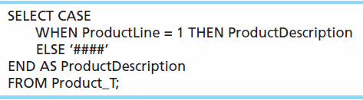
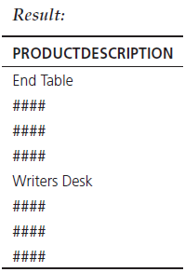
Conditional Expressions Using Case Keyword
A CASE expression acts like an if-then statement. It allows you to choose what will appear in a column of the result set, depending on a condition.
Notes:
SQL does not include an IF-ELSE statement, unlike procedural programming languages. The CASE keyword was introduced to accommodate this need.
The CASE syntax has four possible forms.
The CASE form can be constructed using either an expression that equates to a value or a predicate. The predicate form is based on three-value logic (true, false, don’t know) but allows for more complex operations. The value expression form requires a match to the value expression. So, these are the first two forms.
NULLIF and COALESCE are the keywords associated with the other two forms of the CASE expression.
The query:
SELECT CASE
WHEN ProductLine = 1 THEN ProductDescription
ELSE ‘####’
END AS ProductDescription
FROM Product_T;

Slide 29
More Complicated S Q L Queries
Production databases contain hundreds or even thousands of tables, and tables could include hundreds of columns.
So, sometimes query requirements can be very complex.
Sometimes it’s useful to combine queries, through the use of Views.
If you use a view (which is a query), you could have another query that uses the view as if it were a table.

Slide 30
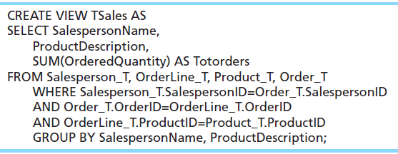
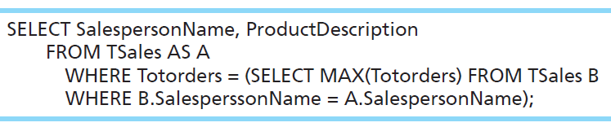
Using a View in Your Query
For each salesperson, list his or her biggest-selling product.
The view:
The query using the view:
Notes:
Here we see an example of creating a view, which will be a permanent object in the database (like a table). Then we use the view as if it is a table. We discuss views in more detail later in this chapter.
The view is called TSales, and consists of an aggregate query involving a join of three tables. TSales, returns the total sales of each product sold by each salesperson.
The query below it uses TSales as if it were a table. Note that this query involves a correlated subquery. This query shows the biggest selling product for each salesperson.
The view:
CREATE VIEW TSales AS
SELECT SalespersonName,
ProductDescription,
SUM(OrderedQuantity) AS Totorders
FROM Salesperson_T, OrderLine_T, Product_T, Order_T
WHERE Salesperson_T.SalespersonID=Order_T.SalespersonID
AND Order_T.OrderID=OrderLine_T.OrderID
AND OrderLine_T.ProductID=Product_T.ProductID
GROUP BY SalespersonName, ProductDescription;
The query using the view:
SELECT SalespersonName, ProductDescription
FROM TSales AS A
WHERE Totorders = (SELECT MAX(Totorders) FROM TSales B
WHERE B.SalesperssonName = A.SalespersonName);

Slide 31
Tips for Developing Queries
Be familiar with the data model (entities and relationships)
Understand the desired results
Know the attributes desired in results
Identify the entities that contain desired attributes
Review E R D
Construct a WHERE equality for each link
Fine tune with GROUP BY and HAVING clauses if needed
Consider the effect on unusual data
Notes:
It is important to test your query against a set of test data that includes unusual data, missing data, impossible values, etc.

Slide 32
Query Efficiency Considerations
Instead of SELECT *, identify the specific attributes in the SELECT clause; this helps reduce network traffic of result set
Limit the number of subqueries; try to make everything done in a single query if possible
If data is to be used many times, make a separate query and store it as a view
Notes:
Subqueries can be very useful, but can also cause computational overload. This is especially true for correlated subqueries. Suppose for example, you had a correlated subquery where the outer query was processing through 10,000 rows. This means the subquery would execute 10,000 times! So, in effect, that one overall query involves 10,001 real queries.
This is another reason it is important to test your queries. Not only must they be able to execute, but they should produce valid results, in a reasonable amount of time.

Slide 33
Guidelines for Better Query Design (1 of 2)
Understand how indexes are used in query processing
Keep optimizer statistics up to date
Use compatible data types for fields and literals
Write simple queries
Break complex queries into multiple simple parts
Don’t nest one query inside another query
Don’t combine a query with itself (if possible avoid self-joins)

Slide 34
Guidelines for Better Query Design (2 of 2)
Create temporary tables for groups of queries
Combine update operations
Retrieve only the data you need
Don’t have the D B M S sort without an index
Learn!
Consider the total query processing time for ad hoc queries
Notes:
All options are not available with every DBMS, and each DBMS has unique options due to its underlying design. You should refer to reference manuals for your DBMS to know which specific tuning options are available to you.

Slide 35
Using and Defining Views
Dynamic View
A “virtual table” created dynamically upon request by a user
No data actually stored; instead data from base table made available to user
Based on S Q L SELECT statement on base tables or other views
Materialized View
Copy or replication of data, data actually stored
Must be refreshed periodically to match corresponding base tables
Notes:
Views provide users controlled access to tables. The term “base table” refers to the table containing the raw data.
So, a dynamic view is a “virtual table”, whereas a materialized view is an actual table generated by copying data from the base tables queried.

Slide 36
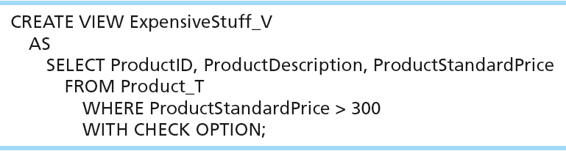
A Sample Create View Command
View has a name
View is based on a SELECT statement
CHECK_OPTION works only for updateable views and prevents updates that would create rows not included in the view

Slide 37
Advantages of Dynamic Views (1 of 2)
Simplify query commands
Assist with data security
Enhance programming productivity
Contain most current base table data
Use little storage space
Provide customized view for user
Establish physical data independence
Notes:
Note: Although views assist with data security, don't rely solely on views for security. There are more important security measures.

Slide 38
Advantages of Dynamic Views (2 of 2)
Use processing time each time view is referenced
May or may not be directly updateable
As with all S Q L constructs, you should use views with discretion

Slide 39
Routines and Triggers
Routines
Program modules that execute on demand
Functions
routines that return values and take input parameters
Procedures
routines that do not return values and can take input or output parameters
Triggers
routines that execute in response to a database event (INSERT, UPDATE, or DELETE)

Slide 40
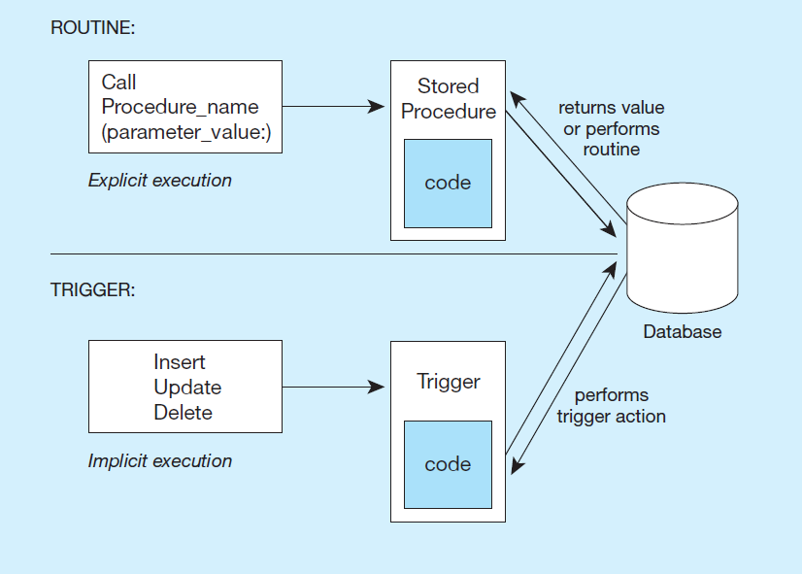
Figure 6-13 Triggers Contrasted with Stored Procedures (Based on Mullins 1995)
Procedures and functions are called explicitly. Triggers are event-driven.
Notes:
Procedures and Functions are called explicitly by the user of the database (for example an application program). When calling a procedure or function, you may pass it parameters. Functions, unlike procedures, will actually return a value. In both cases, there could be several queries or updates done to the database.
Triggers are not called explicitly. Instead, they are invoked as a result of some sort of database action, such as inserting a new record, modifying an existing record, or deleting a record. They could also be invoked as a result of a DDL statement to ALTER a table.

Slide 41
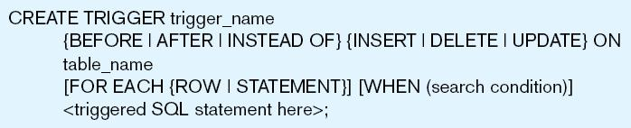
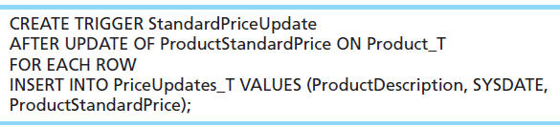
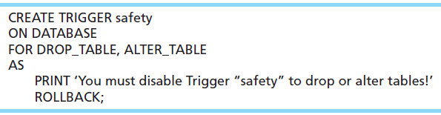
Figure 6-14 Simplified Trigger Syntax, S Q L:2008
Example D M L trigger
Example D D L trigger
Notes:
Triggers may occur either before, after, or instead of the statement that aroused the trigger is executed. DML triggers may occur on INSERT, UPDATE, or DELETE commands.
Question: Remember what DML stands for?
Answer: Data Manipulation Language.
Question: Remember what DDL stands for?
Answer: Data Definition Language
This sample DML trigger will execute after an update of the ProductStandardPrice column of the Product_T table. It will add a new row to the PriceUpdates_T table, and use the new values of the product description and price (from the update) for this new row.
DML trigger:
CREATE TRIGGER StandardPriceUpdate
AFTER UPDATE OF ProductStandardPrice ON Product_T
FOR EACH ROW
INSERT INTO PriceUpdates_T VALUES (ProductDescription, SYSDATE,
ProductStandardPrice);
DDL triggers are generally most useful to database administrators.
DDL trigger::
CREATE TRIGGER safety
ON DATABASE
FOR DROP_TABLE, ALTER_TABLE
AS
PRINT ‘You must disable Trigger “safety” to drop or alter tables!’
ROLLBACK;

Slide 42
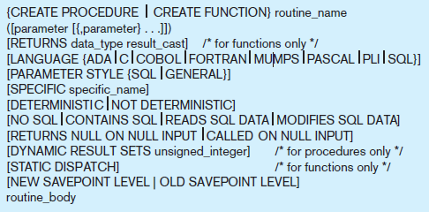
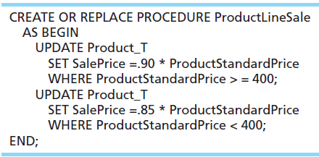

Figure 6-15 Syntax for Creating a Routine, S Q L:2011
Example D D L trigger
Calling the procedure
Notes:
The stored procedure code:
CREATE OR REPLACE PROCEDURE ProductLineSale
AS BEGIN
UPDATE Product_T
SET SalePrice =.90 * ProductStandardPrice
WHERE ProductStandardPrice > = 400;
UPDATE Product_T
SET SalePrice =.85 * ProductStandardPrice
WHERE ProductStandardPrice < 400;
END;

Slide 43
Data Dictionary Facilities
System tables that store metadata
Users usually can view some of these tables
Users are restricted from updating them
Examples in Oracle 12c
D B A_TABLES – descriptions of tables
D B A_USERS – information about the users of the system
Examples in Microsoft S Q L Server 2016
sys.columns – table and column definitions
sys.indexes – table index information
Notes:
All of these tables and views are used internally by the DBMS. But you can also query them. For example, you could find the owners of a company’s tables. Here is an example if PVF’s database was stored in an Oracle DBMS:
SELECT OWNER, TABLE_NAME FROM DBA_TABLES WHERE TABLE_NAME = ‘PRODUCT_T’;

Slide 44
S Q L Enhancements/Extensions (1 of 2)
User-defined data types (U D T)
Subclasses of standard types or an object type
Analytical functions (for O L A P)
CEILING, FLOOR, S Q R T, RANK, DENSE_RANK, ROLLUP, CUBE, SAMPLE,
WINDOW – improved numerical analysis capabilities
New Data Types
BIG INT, MULTISET (collection), X M L
CREATE TABLE LIKE
create a new table similar to an existing one
MERGE

Slide 45
S Q L Enhancements/Extensions (2 of 2)
Programming extensions
Persistent Stored Modules (S Q L/P S M)
Capability to create and drop code modules
New statements: CASE, IF, LOOP, FOR, WHILE, etc.
Makes S Q L into a procedural language
Oracle has propriety version called P L/S Q L, and Microsoft S Q L Server has Transact/S Q L

Slide 46

Copyright

